Slide 1
An Introduction to RF with R and R Studio
CSC 859, Spring 2020
Ken Rauen, with help from V. Sura
SFSU

Slide 2
Outline
1. Introduction
2. Installing R Studio via Anaconda
3. RF Tutorial using R Studio
4. Common issues

Slide 3
What is R?
R is a programming language/ environment that is used for statistical computing and graphics (which includes AI/ ML) ‘
Released in 1993, R in recent years has been consistently listed among the top computer languages used in industry and beyond, being one of the most commonly used for running stats and data analysis as a whole.
Includes robust library with even more open-source packages available online

Slide 4
What is R Studio?
R Studio is an IDE (integrated development environment) for R that serves as a user interface for working with R.
Being that it is built upon R, you can do everything you would normally do in R with R Studio, with the added benefit of being able to utilize a graphical user interface (i.e. you can click on stuff instead of doing everything in the terminal).
Conveniently, R Studio can be installed through Anaconda (as we used to install python), so you can download, install, and launch R Studio through your existing Anaconda installation. (Note, the installation of R Studio includes with it the R language, so don’t worry about having to install R seperatly, for it will already be handled for you)

Slide 5
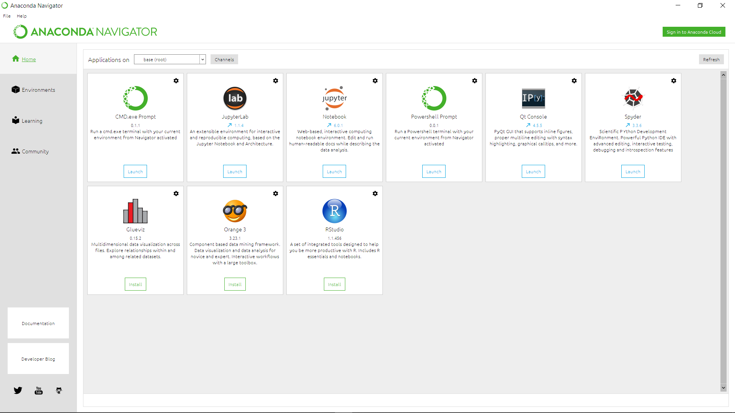
Installing R Studio in Anaconda
1) First, you want to launch your existing installation of Anaconda Navigator. You should see a box for R Studio, as shown here, circled in red.

Slide 6
Installing R Studio in Anaconda
2) Next, you want to click on install, which should then automatically run you through the installation process.
A video showing how to do this can be found here

Slide 7
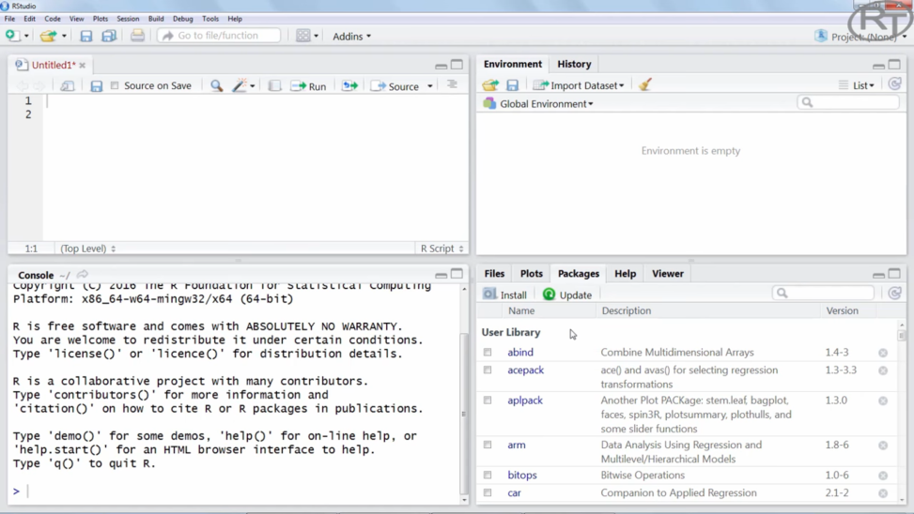

Using R Studio in Anaconda
3) Next, from the Anaconda Navigator you should now be able to launch R Studio. You should spend a bit of time familiarizing yourself with R and R Studio. This tutorial here should help. Below is a screenshot of R Studio from the tutorial

Slide 8
R/ R Studio without Anaconda
If you’re having trouble installing R Studio via Anaconda, stand alone installs of both R and R Studio are fairly straight forward, so this may be your best bet.
To do this, first download the latest version of R via one of the provided mirrors online here.
Once that has installed, you should proceed to download and install the latest version of R Studio from their website. R Studio is open source for non-commercial use (which means free for us). You can get that here.
Concerning installation for both, follow the recommended/default options for everything and you should be fine. This should be the same for Mac and PC (If all else fails, reach out and we’ll work through the install together).

Slide 9
Using R Studio in Anaconda
The next slide will be a screenshot of R studio in the middle of running one of the RF tutorials provided in the course materials (this one), in which I’ll explain the various windows and what they do.

Slide 10
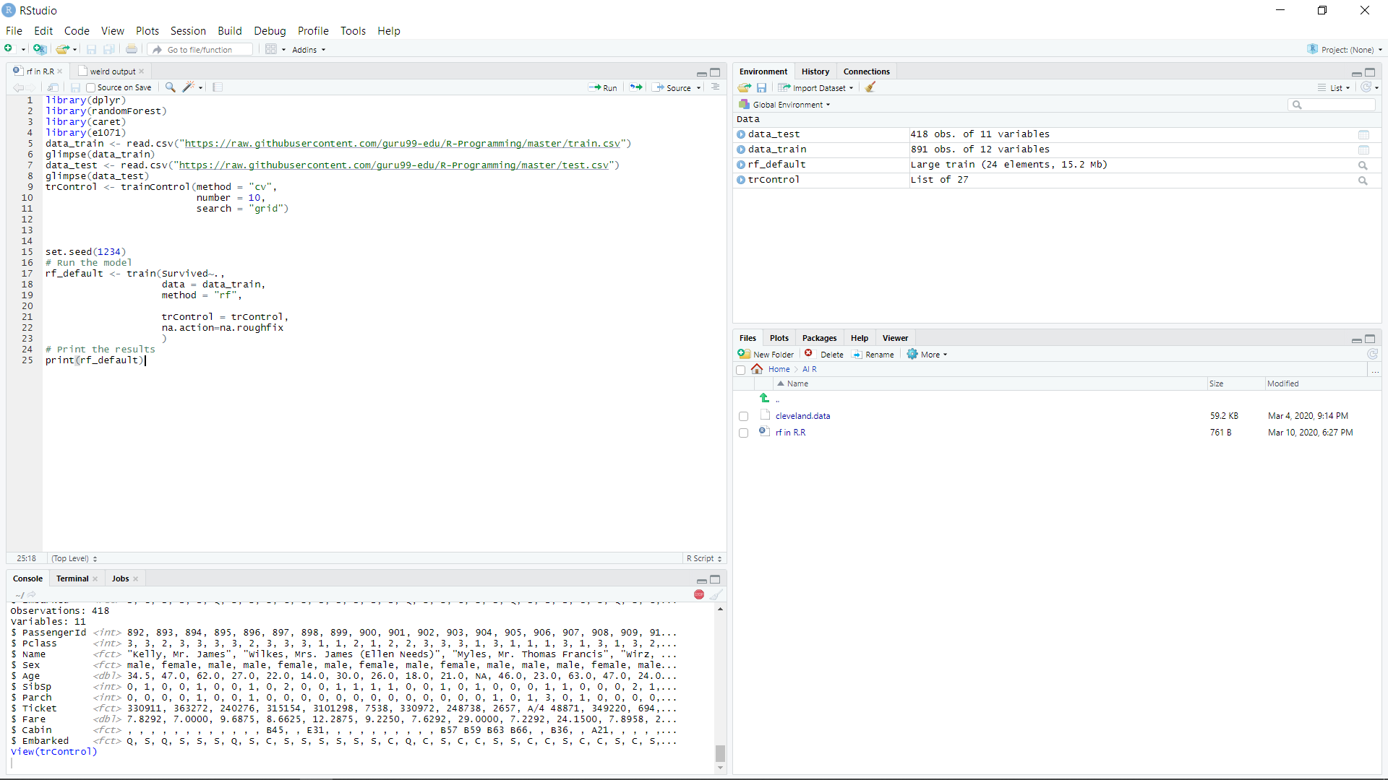
Running RF tutorial in R Studio

Slide 11
Running RF tutorial in R Studio
This box in the upper left hand of the screen represents a script file. (a .R file) Here, you can type out code that is then saved and ran via the console. Unless you’re using the console to code (which is fine too), this is where you’ll spend a lot of your time. As seen, code ran here will output to the console below. To run code, simply highlight what you want ran, and click on “run” as shown above

Slide 12
Running RF tutorial in R Studio
Next, the box below is where you can access your console and terminal. This is where you would run chunks or lines of code as is without running it from a script. This is also where the output of your code will be displayed. As show, what you see there is the result of line 8, glimpse(data_test) in the script above.

Slide 13
Running RF tutorial in R Studio
Next, this box to the right shows you what data and variables are currently loaded by R. As seen, data_test, data_train, rf_default, and trControl, can also be seen at lines 5, 7, 9, and 17. This is because the code has been run, so the items are loaded into memory.

Slide 14
Running RF tutorial in R Studio
Lastly, the box in the bottom right hand corner is where you can access your working folder, (“Home >AI R” in my case), sort through your library, install libraries (as covered in the youtube tutorial). Any plots or graphs from your code will also show up here.

Slide 15
RF tutorial using R Studio
Next, we will walk through running the Random Forest in R as needed by HW#4. I’m using the e1 data set, and used this tutorial as a rough outline (feel free to try running the tutorial on your own first.
The next slide will be picture of the code I used for HW4. Read it over and try to follow the logic of what's going on, then I’ll explain each chunk in further detail. Note, if you’re unfamiliar with programming, green text following “#” is only for comments in the code. It is not read by R, and is not needed to run. Its recommended that your document your code for readability sake of yourself and others.

Slide 16
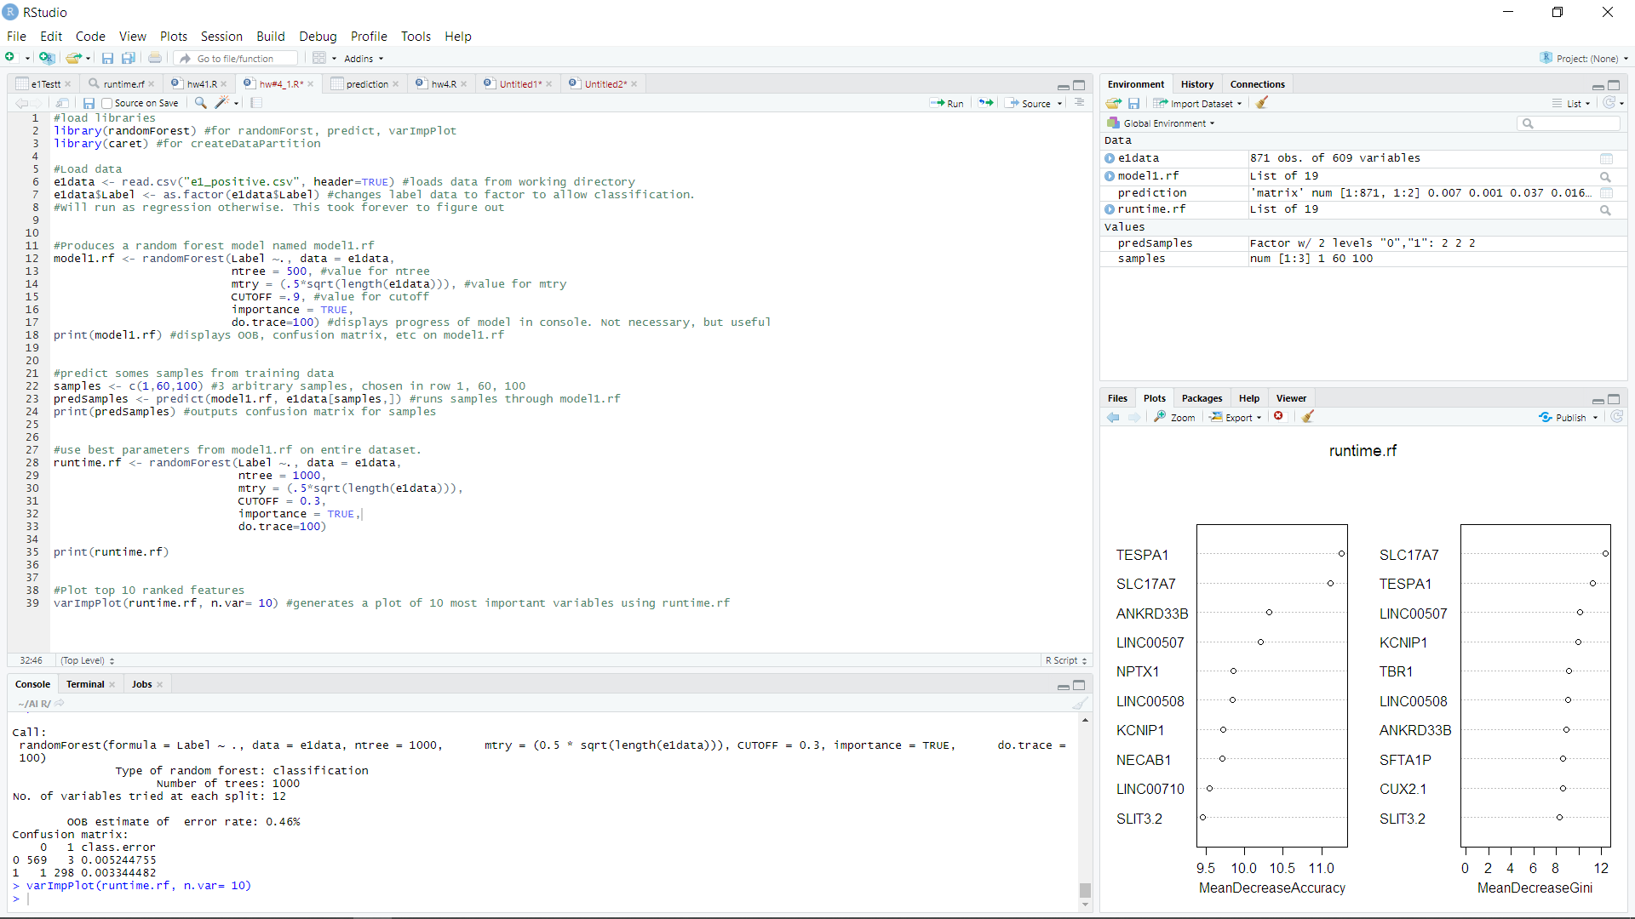

Slide 17
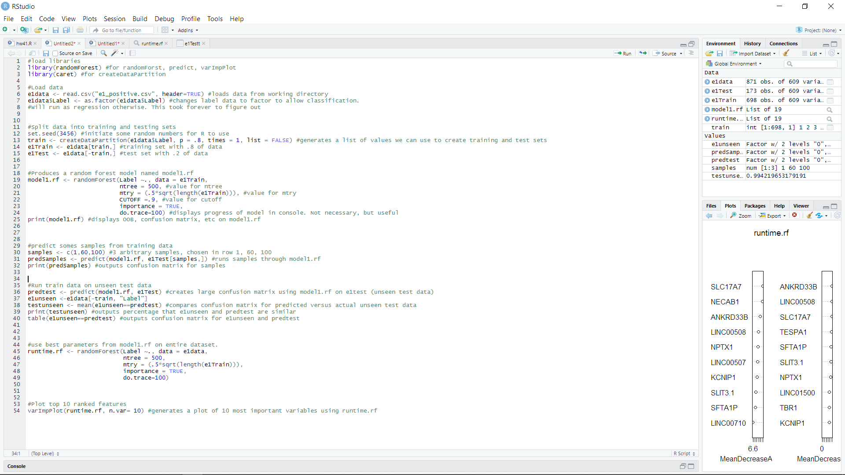
RF tutorial using R Studio
First things first, you want to make sure you have the correct libraries installed. If not, your computer will not understand the code it is trying to run and will throw error messages. The libraries used in this tutorial are
randomForest
caret
“randomForest” allows R to use functions that are specifically designed to create and run RF models. There are plenty of other packages you can use, but this one is simple and effective. “caret” on the other hand is a data processing powerhouse that can be used for a number of features. Were only using 1 in this example however. I suggest googling these packages to skim through their documentation
Refer to the video on using R Studio if you’re having trouble seeing what libraries are installed, or how to install them in general.

Slide 18
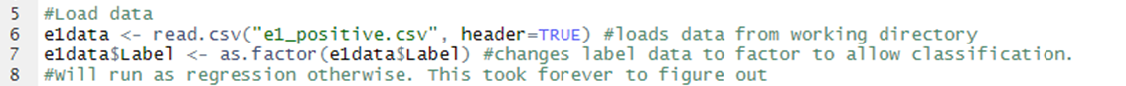
RF tutorial using R Studio
Second, were going to load some data. This can go either in a script file, or be ran via the console. If successful, you should see dataset e1 pop up in your global environment (the upper right hand window).
Here, you will read the e1 data (which can be downloaded via ilearn) into a dataset named e1data. This can be named anything, but I suggest you use something that pertains to the dataset you’re using. Note: because I have e1 positive.csv in my working directory, I can call it by name. Otherwise, you’ll need to specify to the program where it is on your computer.
The next line, e1data$Label <- as.factor(e1data$Label), is changing the data type of the last column in our set to a discreet, rather than continuous value. While this doesn’t change our “Label” values (1 or 0), it does specify to the computer than it can only be a 1 or 0, so classification can be ran. You’ll only be able to run a regression here otherwise.

Slide 19
RF tutorial using R Studio
Our next step is to build the model.
Here, were using the randomForest() function to produce an RF model named “model1.rf” (Again, this can be named anything, but common sense is king here). As shown by the values between parenthesis, this is where you specify your paramters.
For the items between parenthesis:
“Label”, is referring to the name of our outcome column, i.e. the thing were trying to predict. The “~.” is needed.
“data = e1Train” refers to the data we want the model trained on
“ntree =“ is the number of trees we want in out model
“mtry” = like ntree, this is our value for mtry.
“CUTOFF= “ value for cutoff. Etc.

Slide 20
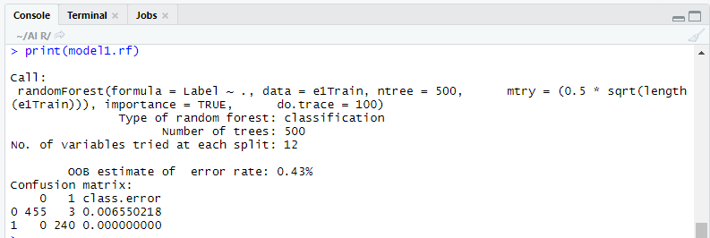
RF tutorial using R Studio
Our next step is to build the model.
The key here is to run this model using the recommended parameters values for ntree, mtry, and cutoff. Each time you run, you’re going to want to run the print(model1.rf) command to display the results of your model. Record these, each time and record what values give you the lowest OOB percentage. Output from print(model1.rf) should look something like:
For this model with these parameters…:
OOB ERROR
CONFUSION MATRIX

Slide 21
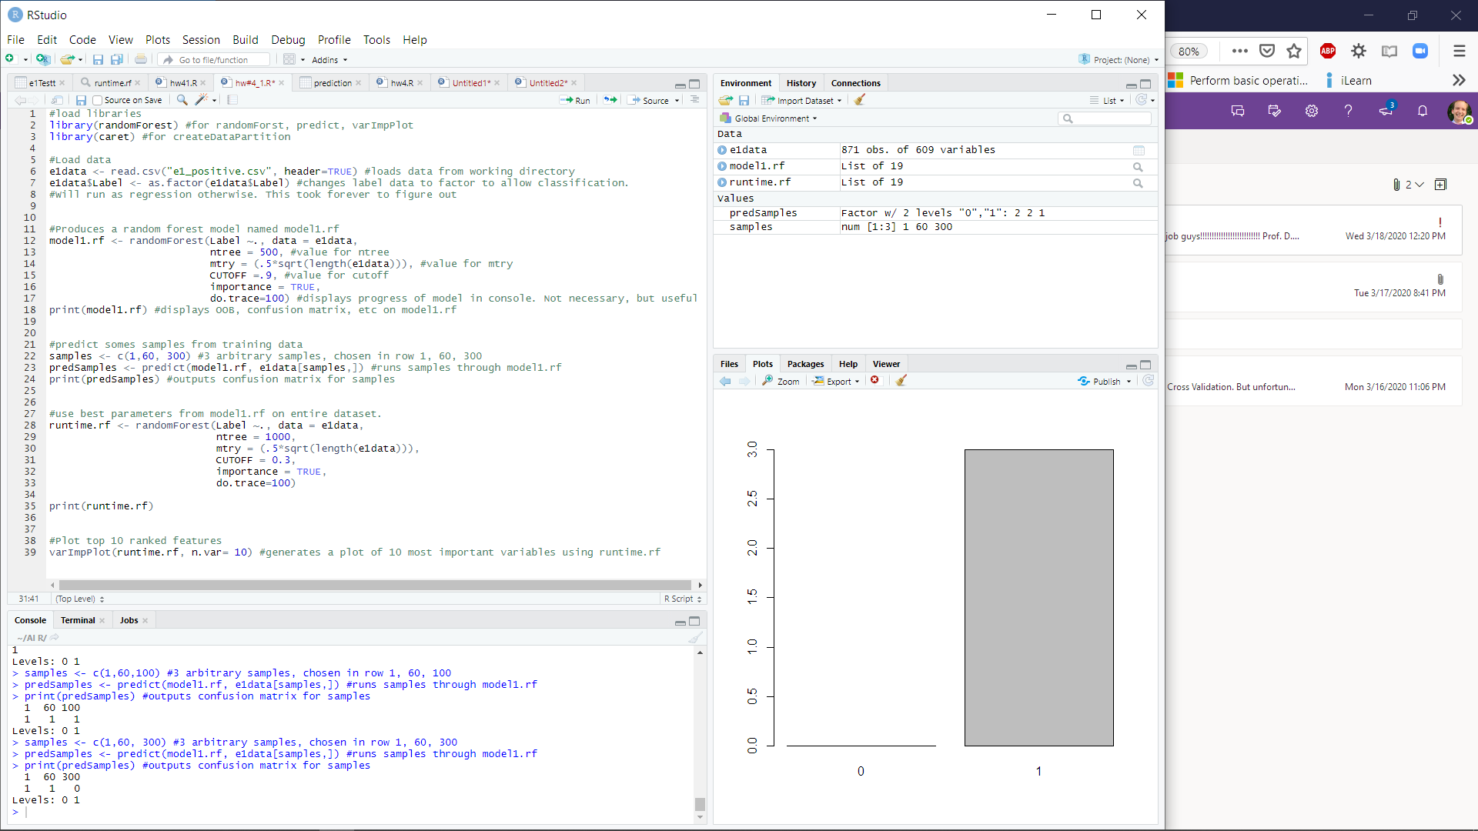
RF tutorial using R Studio
Now that we have our RF model, we can run a few samples from the data through it
As show, this is just some fairly rudimentary code to run individual samples through your new model.
“samples” is just a list of numbers that will tell the model which row to run a prediction on. I’ve chosen 1, 60, and 300, but it can be anything, as long as it’s a number equal to or smaller than the number of rows in e1Test.
predSamples will store the output of predict(). The first item, (model1.rf, …) is the model we want to use, and (…., e1data[samples, ]) is the data we’ll run on. Note: [samples, ] essentially inputs [1, ], [60,], [300, ], where the first number represents what row to pick, and the blank value after the comma tells the data to use all columns for that row. Calling [, 60] would have the opposite effect, vice versa.

Slide 22
RF tutorial using R Studio
Now that we have our RF model, we can run a few samples from the data through it
Lastly, running line 32, print(predSamples) (or whatever you named your variable on line 31), should output something like this in your console:
This matrix shows the samples you selected by row (rows 1, 60, 300 of the data, with their predicted label/class below (1, 1, 0). Try messing around with other sample values
Note: Your values will probably be different (different initial samples), but the format should correspond to how many samples you’ve selected, like shown i.e. 3 columns because I ran 3 variables.

Slide 23
RF tutorial using R Studio
Now that we’ve built a model, found the best parameters, and explored the results a bit, we can use the values who’s combination yielded the lowest OOB error for our runtime engine
This is just like what we did to build the model1.rf, but we’re going to use the best parameters on the entire dataset. Note: these values do not necessarily indicate the best parameters
As before, print runtime.rf, and visually compare its output with that of model1.rf. This, as before, will give you a printout of your OOB and a confusion matrix for the model

Slide 24
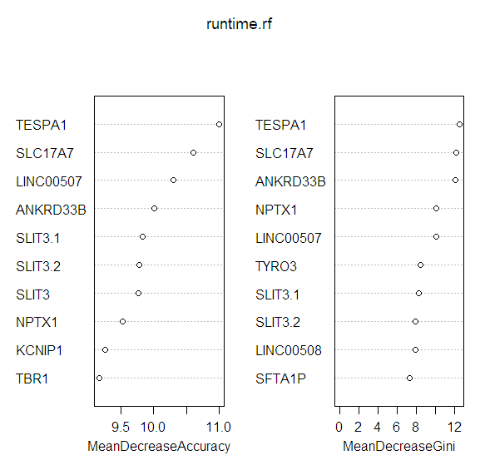
RF tutorial using R Studio
Lastly, if you would like to produce MDA values, the randomForest package is kind enough to include a function that does this for you
As shown, the first item in the parenthesis of varImpPlot is the model you wish to use (runtime.rf in this case) and “n.var=“ is the number of features you want to list. This should output a plot in the bottom right corner of the screen.

Slide 25
Common issues
Many times, errors you get while writing code can be things as simple as typos or capitalization errors. If something isn’t running, make sure the things you’re trying to implement are all spelled correctly, etc.
If not capitalization, make sure the various parameters your calling within a function (ntree and mtry within randomForest() for example) all have a comma separating them. Your system needs these to know when one value ends, and another begins, etc.

Slide 26
Common issues/ Missing Values
One issue you may have in getting your model to run is there are values missing, so it gives you an error. There are a few ways and methods to circumvent this issue, ill explain one within randomForest() here.
Within randomForest(), you can specify how your model handles missing values by adding a new parameter within the parenthesis. “na.action=” is this parameter (just as ntree=“, but you need to specify how it is you want to fill in the missing data
(na.action=na.omit) will omit the data,
Example: iris.narf <- randomForest(Species ~ ., data= iris.na, na.action=na.omit)
(na.action=na.roughfix) will impute the missing value by its median value.
Example: iris.narf <- randomForest(Species ~ ., data= iris.na, na.action=na.roughfix)
For more info, check out https://rdrr.io/rforge/randomForest/man/na.roughfix.html

